Slide 1
Using dynamic simulations
on MRT passenger traffic data
to optimize service performance
Dominic B. Dayta

Slide 2
Presentation map
terminus:
Motivation
Developing the simulation model
Simulation results
terminus:
Recommendations for further improvements

Slide 3
Station I
Motivations

Slide 4

image source:
Facebook

Slide 5
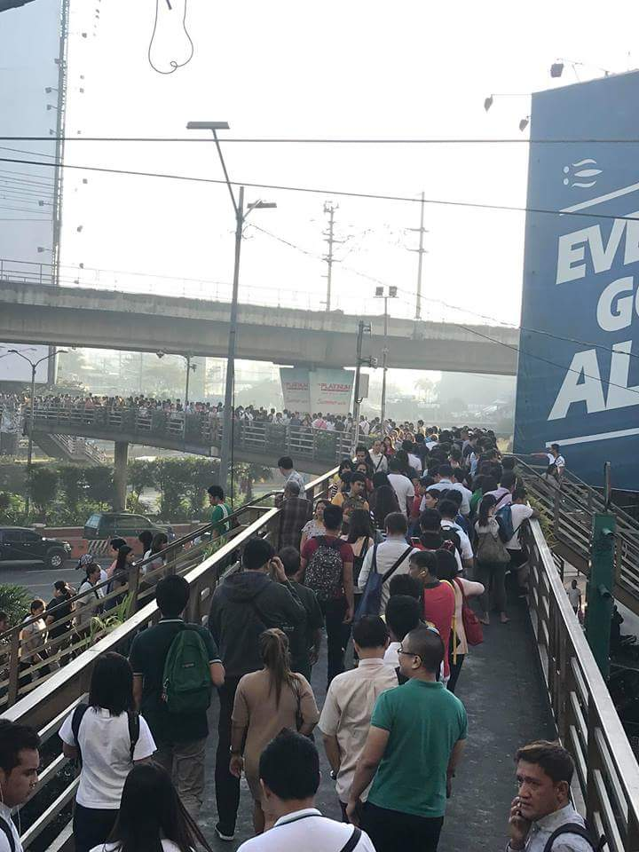
Queue for
MRT North Avenue reaches Paramount overpass
January 24, 2018
image source:
Facebook

Slide 6
Let’s ditch the formalities…
The MRT is an unmitigated disaster.

Slide 7
Motivation
Despite serving an average of 270,000 daily passengers in February 2018 (Rappler), the MRT has continuously stayed in the public consciousness for frequent service interruptions and total breakdowns.
In fact, in January alone, the MRT line has reportedly suffered 27 breakdown incidents, culminating with one coach actually catching fire in January 26.
Cited:
Rey, Aika (February 9, 2018). “MRT3 suffers almost daily breakdowns since start of 2018”. Rappler.com

Slide 8
2017 In Figures | MRT Failures
Just how bad has MRT gotten? A report shows that the line experienced a total of 516 service breakdowns in 2017, a high jump from last year’s recorded 441.
MRT Breakdowns in 2017, by type
versus the previous year
Train unloading:
Service
Interruptions (7%)
Train
Unloadings (87%)
449
379
2017
2016
Provisional Service
Service interruptions:
41
38
Data source:
Bueza, Michael (January 1, 2018). “MRT woes: how often do they happen?”. Rappler.com. With an update on November 20, 2018.
2017
2016

Slide 9
2017 In Figures | MRT Failures
The MRT woes data also reveals that the MRT has become terribly incapable of meeting its demand. Most service interruptions are experienced during times of highest ridership volume.

Slide 10
But how did we get here?
Lack of strategic service management.

Slide 11
Motivation
The MRT is overused, under-maintained, and is continuously being run thin by service demand much too high for its capacity.
If anything, these frequent service interruptions are symptomatic of this systemic wear-and-tear on the country’s busiest transit line.

Slide 12
Motivation
This study aims to fill a large hole in MRT maintenance:
A data-driven approach to finding optimal deployment strategies that can adapt to its rising demand.
Through a model that dynamically simulates train and passenger activity in each of the line’s stations, and identifies how conditions such as the number of trains deployed, passenger arrivals, speed, headway (etc) affect overall performance.

Slide 13
Station II
Developing the simulation model

Slide 14
Primary hypothesis
Activity in a given station is the result of the interaction of two parallel processes: train arrival and passenger arrival.
Passenger arrives at station
Trains arrive at station
Passenger joins queue
Passengers unable to board remain in queue

Slide 15
Primary hypothesis
Passengers arrive regardless of how many trains have entered the station, and so it is reasonable to assume that the two processes are independent.
Both passenger and train arrivals are time-dependent. Long queues happen when the rate of train service is unable to meet the rate of passenger traffic.

Slide 16
Primary hypothesis
By simulating how these two processes propagate in time, we can study activity in each MRT station in terms of:
queue volume, and
waiting time between train arrivals.
Dependent on the following settings:
Speed and capacity of the trains
Number of trains deployed
Rate of passenger arrival

Slide 17
Delimitations
Due to restrictions on time and resources, this simulation study will only focus on how queue volume and train inter-arrivals are affected by the number of deployed trains.
We will also explore the effect of train speed on MRT performance.

Slide 18
Delimitations
We will not, however, explore the propagation of transit breakdowns and other service interruptions.
Because the purpose of this study is to find optimal service settings, we begin (without argument) on the most basic fact:
We need well-maintained, reliable train coaches.

Slide 19
Delimitations
We will also simulate only one line, particularly the Southbound MRT, extending across 13 stations from North Avenue in Quezon City to Taft Avenue in Pasay.
For further exploration, it shouldn’t be complicated to modify the code to consider both south and northbound lines.

Slide 20
The simulation model

Slide 21


The simulation model
The simulation model is a dynamic interaction of two algorithms:
Train arrivals
Passenger arrivals

Slide 22
Train arrivals
Affected by the following variables:
Speed (specifically, its average running speed)
Count (functional trains deployed for service)
Random delays
(very important: trains will not always arrive at the expected time. If on average the next train will arrive in 5 minutes, it can arrive a little earlier or later)

Slide 23
Train arrivals
The algorithm:
(The process first. Mathematical rigor follows.)
1. MRT opens, deploy first train at first station (southbound) at t=5 minutes
2. Deploy succeeding trains 5 minutes apart
3. Equation (1) gives the train’s arrival time at the next station
4. At each station, train parks for p minutes to load passengers
Iterate
100
times
5. If a train is still parked at the next train’s expected arrival, that next train will delay itself until 1 minute after the previous train has departed.
6. After unloading all passengers at the last station, Equation (2) gives the expected arrival for each train to recirculate towards the first station of the line.

Slide 24

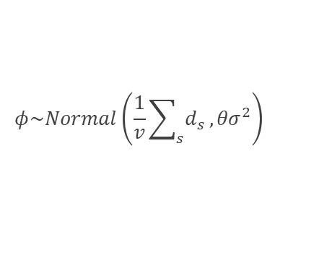
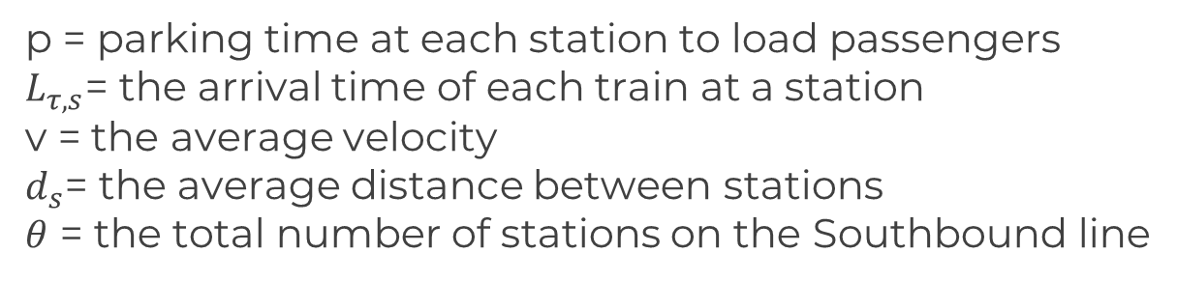
Train arrivals
The Math
$$L_{τ,s}=\max\left\{\left(L_{τ,s−1}+p\right)+\frac{1}{v}d_{s}+e,L_{τ−1,s}+p+1 \right\}$$
Equation 1:
Equation 2:
$$L_{τ,1}=\max\left\{L_{τ,θ}+θp+φ,L_{τ−1,1}+p+1\right\}$$
Where
p = parking time at each station to load passengers
$L_{τ,s}$= the arrival time of each train at a station
v = the average velocity
$d_{s}$= the average distance between stations
$θ$ = the total number of stations on the Southbound line
Random components:
$$φ\sim Normal\left(\frac{1}{v}\sum_{s}{d_{s}},{θσ}^{2}\right)$$
$e\sim Normal\left(0,σ^{2}\right)$

Slide 25

Passenger arrivals
The arrival of passengers at each station will be simulated from actual MRT passenger traffic data.
The goal is to replicate as close as possible the realities of MRT operations, but still allow for random variations, such as sudden surges and shortages in the number of arriving passengers.
The algorithm will be in the form of a function:
arrivals(time 1, time 2, station)
Which gives the number of new passengers that have arrived at the station, in the interval between time 1 to time 2.

Slide 26
Passenger arrivals
The algorithm:
1. Determine the hour interval* into which time 2 belongs.
2. Open MRT passenger traffic data and generate $F_{t}(x)$: the cumulative distribution function of all possible arrivals within that hour for that station
3. Using the inverse sampling method, generate a random number from the Uniform(0,1) distribution and call this q.
Iterate
100
times
4. The number of passengers that arrive within that hour is then given by finding x whose $F_{t}(x)$ is the closest (and less than) the value q.
5. Then the number of people that arrives between time1 and time2 is given by Equation (3).
6. Generate the arrivals for the entire run of train operations.

Slide 27
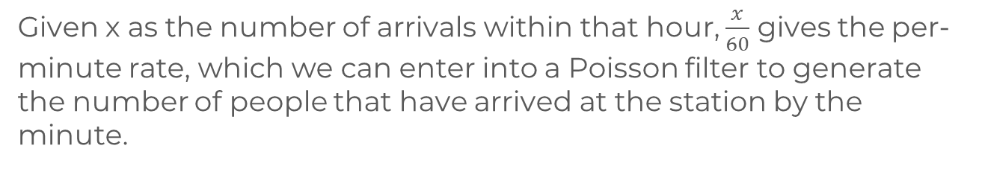
Passenger arrivals
The Math
Equation 3:
$$arrivals\left(time1,time2,station\right)\sim Poisson\left\{\frac{x}{60}\left(time2−time1\right)\right\}$$
Given x as the number of arrivals within that hour, $\frac{x}{60}$ gives the per-minute rate, which we can enter into a Poisson filter to generate the number of people that have arrived at the station by the minute.
The inverse sampling method using the CDF is further discussed in
Aalto University, N. Hyvönen. “Computational methods in inverse problems.” (link in the notes)
Notes:
Link to resource: https://noppa.tkk.fi/noppa/kurssi/mat-1.3626/luennot/Mat-1_3626_lecture12.pdf

Slide 28
Pain points
Hypothesized values of p
Pain point: the MRT passenger traffic data only gives the number of entries and exits at each station per hour interval, but does not identify whether these are southbound or northbound passengers.
By station
To simulate the arrival of southbound passengers, we will have to enforce another filter.
Solution: Multiply the number of arrivals at the station by p, where
p = the percentage of passengers arriving at a station that are actually going southbound.

Slide 29

The simulation model
The algorithms for Train Arrivals and Passenger Arrivals communicate via a third algorithm for Train Loading.
Train arrivals
Train Loading
Passenger arrivals

Slide 30
Train loading
The algorithm:
1. Arrive at station
2. If there are any, a certain number of passengers inside will exit
3. New passengers then enter and load the train
Iterate
100
times
4. After p minutes, where p = the parking time at each station, the train stops loading passengers and departs
5. Passengers who are not able to get on the train will remain on the station platform and be part of the queue

Slide 31
Train loading
Note:
This is due more to the author’s personal observation, but even when the train has enough capacity to accommodate everyone at the station, not everyone gets in.
We assume that at each station, passengers will only attempt to fill up to 90% of the train’s current capacity. Then the number of people that get on will be defined by Equation 4:
$$people boarding=min\{queue+new arrivals, 0.9(remaining capacity on train)\}$$
When the total of the queue and new arrivals is too large, then only enough people will board the train so as to fill 90% of the remaining capacity on train.

Slide 32
Pain points
Proportion of passengers unloading
By station, hypothetical, assumed uniform through time
Pain point: Like with southbound entries, we are also not sure how many passengers inside a single train will unload at each station.
The solution is also to propose a set of hypothetical values. Note though that these remain logical values, based on observation. It’s safe to assume that more people will be unloading at stations farther from the start end, particularly at high-traffic stations like Shaw, Ayala, Buendia, and Taft.

Slide 33
Pain points
The last pain point to discuss concerns the fact that available MRT passenger traffic data only goes as far as 2014.
We use the 2014 data and note that the results of the simulations are limited to this time frame only.
This should not be a big problem, however, as recent data can easily be fed into the simulation. This presentation merely demonstrates what the simulation model is capable of doing.

Slide 34
Station III
Simulation results

Slide 35


MRT Performance | Default settings
We look at some reported defaults for MRT’s deployment settings to guide the simulation. Note that the data describes the MRT’s performance in 2016. But knowing the system has not revamped much of its infrastructure, there should be no problem using these settings on 2014 data.
Number of deployed trains and average headway, 2016
20
In contrast, the Singaporean MRT reports speeds of
Trains deployed each day
45
80
kilometers per hour (average)
kilometers per hour (average)
4.5
minutes wait for the next train
Data sources
Land Transportation Authority, Singapore. “Circle Line Fast Facts”. Lta.gov.sg
Yee, Jovic (2017). “MRT eyes bigger capacity, faster trains in 2017”. Philippine Daily Inquirer

Slide 36
MRT Performance | Default settings
We look at some reported defaults for MRT’s deployment settings to guide the simulation. Note that the data describes the MRT’s performance in 2016. But knowing the system has not revamped much of its infrastructure, there should be no problem using these settings on 2014 data.
Passenger capacity of the MRT-3:
1
:
1,182
A single train,
With 3 cars
Includes both standing and sitting passengers
Source: DOTC

Slide 37
A dwindling service
Waiting time on platform between train arrivals against the number of trains deployed (speed = 45kph)
Waiting time
Number of deployed trains

Slide 38
A dwindling service
Waiting time on platform between train arrivals against the number of trains deployed (speed = 45kph)
Waiting time
Number of deployed trains

Slide 39
A dwindling service
Waiting time on platform between train arrivals against the number of trains deployed (speed = 45kph)
Waiting time
Number of deployed trains

Slide 40
A dwindling service
Waiting time on platform between train arrivals against the number of trains deployed (speed = 45kph)
Waiting time
Number of deployed trains

Slide 41
A dwindling service
Waiting time on platform between train arrivals against the number of trains deployed (speed = 45kph)
Waiting time
Number of deployed trains

Slide 42
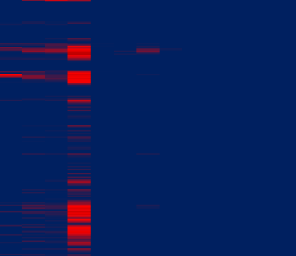
All the lonely people waiting
Knowing the effect of the number of trains on waiting time, how does this affect the number of people on queue to board a train?
5 Trains Running
8 Trains Running
20 Trains Running
4-5am
Time of Operation
9-10pm
North
Shaw
Taft
North
Shaw
Taft
North
Shaw
Taft
Queue depth:
0
500
>1,000

Slide 43
4-5 am
Adopt a new schedule?
Even with twenty trains running we are observing a string of queues of above 500 people in depth in Cubao. These periods correspond to the morning and evening peak hours.
Time of Operation
When the train reaches Cubao, fourth station on the line, it is already too full too accommodate the large inflow of passengers.
Perhaps this suggests that a new schedule ought to be implemented, in which stations are served on a demand-basis.
9-10 pm
North
Cubao
Taft
Queue depth:
0
500
>1,000

Slide 44
Why not make it fast and furious?
Running the same simulations with trains running at 80kph (like the Singaporean MRT), train headways take on a significant improvement even when few trains are running.
Waiting time
Number of deployed trains

Slide 45
Why not make it fast and furious?
Running the same simulations with trains running at 80kph (like the Singaporean MRT), train headways take on a significant improvement even when few trains are running.
Waiting time
Number of deployed trains

Slide 46
Why not make it fast and furious?
The queue situation also improves with faster trains. Below are side-by-side comparisons of the queue depths observed in the simulations when trains run at 45kph (current performance) versus 80 kph (benchmark improvement from SG).
5 Trains Running
45 kph
5 Trains Running
80 kph
4-5am
Time of Operation
9-10pm
North
Shaw
Taft
North
Shaw
Taft
Queue depth:
0
500
>1,000

Slide 47

Why not make it fast and furious?
The queue situation also improves with faster trains. Below are side-by-side comparisons of the queue depths observed in the simulations when trains run at 45kph (current performance) versus 80 kph (benchmark improvement from SG).
8 Trains Running
45 kph
8 Trains Running
80 kph
4-5am
Time of Operation
9-10pm
North
Shaw
Taft
North
Shaw
Taft
Queue depth:
0
500
>1,000

Slide 48
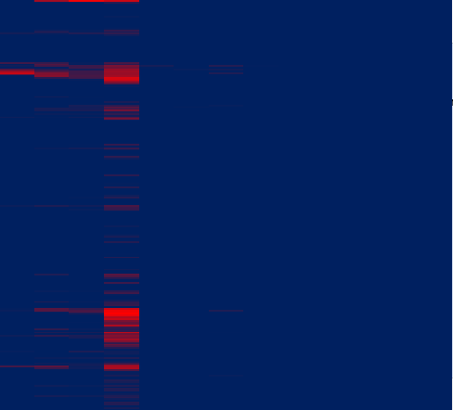
Why not make it fast and furious?
The queue situation also improves with faster trains. Below are side-by-side comparisons of the queue depths observed in the simulations when trains run at 45kph (current performance) versus 80 kph (benchmark improvement from SG).
20 Trains Running
45 kph
20 Trains Running
80 kph
4-5am
Time of Operation
9-10pm
North
Shaw
Taft
North
Shaw
Taft
Queue depth:
0
500
>1,000

Slide 49
Key takeaways
Simulations reveal that the recent 2017 – 2018 MRT performance is horribly incapable of meeting its 2014 demand.
In terms of queue depth, the optimal setting for MRT would be to have at least 20 trains servicing the line, at least during peak hours.
But combining speed and number, the MRT can approach an ideal performance with at least 20 trains running a faster 80kph speed. This is expected to be costly, however.

Slide 50
Key takeaways
With the current coaches (45kph speed), adding more trains improves the first stations on the line but leaves the middle stations problematic.
Therefore, supposing the DOTC does not wish to canvass a large order of new, faster train models, simulations show that its current coaches can still make do, but a change of schedule might be necessary.
Particularly, this schedule should service trains on a demand-basis, paying attention to the middle stations with high passenger inflow, such as Cubao.

Slide 51
Station IV
Recommendations for further improvement

Slide 52
Recommendations
Foremost: perform a second run of the simulation model using the latest data.
The current simulation model considers only the Southbound line. A possible version 2 might be to include the Northbound line.
To verify the inference that a change of schedule might help, it is possible to tweak the current model that deploys “skip” trains towards the most loaded stations at each time point.

Slide 53
Recommendations
Some code optimization might also help. Running the simulation on R using a fairly dated 32bit laptop, total computation time takes upwards of 22 hours.

Slide 54
Further references
Hong, Ling, Wei Li and Wei Zhu (2017). “Assigning Passenger Flows on a Metro Network Based on Automatic Fare Collection Data and Timetable.” Hindawi: Discrete Dynamics in Nature and Society.
Vol. 2017, ID 4373871, 10pp. https://doi.org/10.1155/2017/4373871
Li, Wei and Wei Zhu (2016). “A dynamic simulation model of passenger flow distribution on schedule-based rail transit networks with train delays.” J. Traffic Transp. Eng. (Engl. Ed.) 2016; 3 (4): 364e373

Slide 55
Acknowledgments
The following were instrumental in the development of this study. Due thanks must be given.
Joanna Rose Centillas, for her invaluable input while I was brainstorming this project
EXID, for the music that kept me sane during coding

Slide 56
End of the line

